Slide 1
Environmental Pollution
Presented By
Sadia Chowdhury

Slide 2
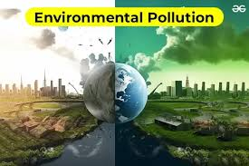
Environmental Pollution
Environmental pollution is the introduction of foreign and potentially harmful elements into the environment. The consequences are particularly important when they damage ecosystems and human societies, especially with regard to health.
It is a contamintion of the environment as a result of human activity and it can be created naturally or artificial means.

Slide 3
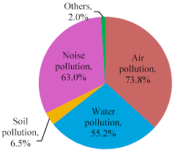
Types of pollution
There are different types of pollution.
The first to be studied were those in which pollutants had physical elements: air pollution, water pollution and land pollution.
Later, by analogy, definitions were provided for noise pollution, light pollution, thermal pollution, and electromagnetic pollution: in these cases, no material substances are introduced into the environment, but intangible agents – such as electromagnetic waves (including light and sound) are.

Slide 4
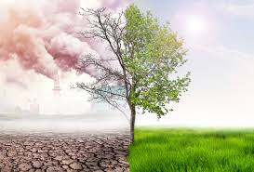
Air pollution
In the long run, the most dangerous pollutants are the greenhouse gases (mainly carbon dioxide), which are responsible for climate change. The air in our cities is also polluted by other gases (such as carbon monoxide) and atmospheric particulate matter (i.e., fine particulate matter).
Finally, the air is often polluted inside homes as well, due to cigarette smoke, insecticide sprays, and especially, in many countries, kitchens with ovens fueled by coal or other highly polluting fuels.

Slide 5
Water pollution and soil pollution
Water pollution now affects virtually all the world's seas, oceans, lakes and rivers. In the sea, the most egregious cases are oil spills from shipping disasters, but the problem of pollution from plastics and particularly microplastics is becoming increasingly urgent.
Fresh water accounts for only 2.5% of all water on Earth – it is the most precious resource for human life. Very often, however, running water is contaminated with chemicals, particularly those known as PFAS (Perfluorinated and Polyfluorinated Alkyl Substances).
Pollution, along with erosion, is now the main threat to soil on our planet, and it has now reached every corner of the world: it has even been found in the most uninhabited areas, such as Antarctica.
Soil pollution is caused both by macroscopic objects such as waste left by humans and by substances that are present in the form of microscopic and therefore invisible particles.

Slide 6
The main causes of pollution
The oldest economic activity, agriculture, today makes extensive use of substances such as pesticides and fertilizers, which are among the main contributors to soil and water pollution.
Industries, and especially large factories, are a major source of air pollution due to gaseous emissions, but also, with their solid and liquid wastes, soil and water pollution. Furthermore, they are among the main contributors to noise and thermal pollution.
The energy sector has historically relied on fossil fuels, which are among the main contributors to climate change. Today the contribution of renewable sources is increasing, but in many countries, such as China, the use of coal, the most polluting fuel, is still predominant.
Another significant contributor to the greenhouse effect comes from transportation, but it also emits other polluting gases, such as carbon monoxide produced by vehicular traffic. Moreover, transportation is one of the leading causes of noise pollution.
Waste – industrial waste but also waste produced by individuals – has a major impact on the environment, especially if it isn’t managed properly. At a local level, landfills are a major source of soil pollution, while on a larger scale so is waste (such as plastic) that reaches the sea via waterways.

Slide 7
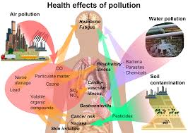
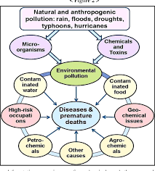
Effects of environmental pollution
Environmental pollution has a harmful effect on human health. According to World Health Organization (WHO) estimates, air pollution is responsible for 7 million premature deaths a year due to respiratory, cardiovascular, and immune system ailments. The damage caused by polluted indoor air must also be taken into consideration.
Water pollution is so widespread that nearly two billion people, or a quarter of the world's population, drink contaminated water on a daily basis.Furthermore, pollutants such as waste from the pharmaceutical and cosmetics industries, when dispersed into the environment, cause an increase in bacterial resistance to antibiotics.
Climate change also means an increase in extreme events such as cyclones, floods and drought.

Slide 8
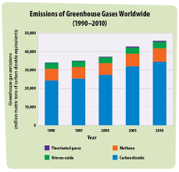
Greenhouse effect
Greenhouse effect is a quite alarming problem . Greenhouse gases are part of Earth's atmosphere. However, in the last century, human activities, primarily from burning fossil fuels that have led to the release of carbon dioxide and other greenhouse gases into the atmosphere, have disrupted Earth's energy balance. This has led to an increase in carbon dioxide in the atmosphere and ocean. The figure in the chart shows the level of carbon dioxide, methane, nitrous oxide in Earth’s atmosphere has been rising consistently for decades and traps extra heat near Earth's surface, causing temperatures to rise.

Slide 9
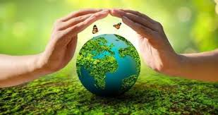
Ways to save our environment
Choosing a Transportation Facility
Avoid using a car for short-distance travel, instead, you can make use of a bicycle which will be beneficial in terms of health as well as in the reduction of air pollution.
Food Choices
As transporting the food across various parts of the country would lead to consumption of considerable fuel, we can minimize the consumption of excessive fuel by choosing food products that have been grown locally and naturally using viable methods. Hence reducing air pollution.
Energy choices
Ensure that you switch off the lights and other electrical appliances when you are not in the room. Unplugging them when not in use would also help to save energy. Use energy-efficient light bulbs.
Usage of Chemicals
Make use of eco-friendly chemicals because these are what we use for washing utensils, cars and homes get washed down into the sewage system that would, in turn, get collected as groundwater.

Slide 10


